Slide 1

Instructions for WEPS DB Update
Mike Sporcic, 817-509-3213
Rick Fasching, 503-273-2425
Bill Kuenstler, 817-509-3363
Gene Hardee, 336-370-3365
2-1-2011

Slide 2
General Comments
This the first revision of the database files since the Nov 1, 2010 roll out of WEPS.
Each user is expected to be able to:
1. Copy the included files to the correct locations.
2. Delete the files as directed.
3. Unzip the files as diercted.

Slide 3
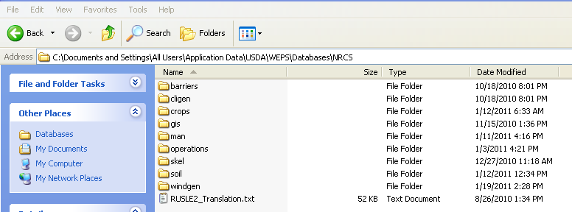
Where are the file stored?
All WEPS files are stored in the C:\Documents and Settings\All Users\Application Data\USDA\WEPS\Databases\NRCS Location.

Slide 4
What files are changing?
Files will be changed in the directories shown below.

Slide 5
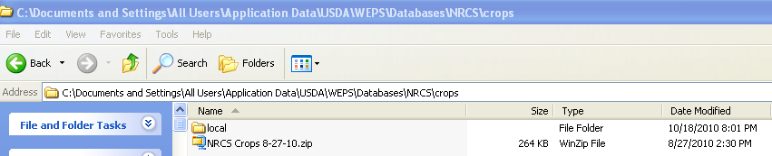
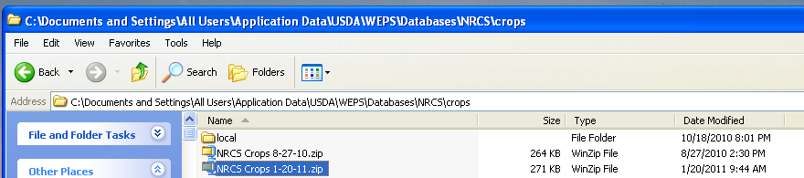
Crops file change
Current file in Crops directory
1. Place the new NRCS Crops 1-20-11 .zip file into the crops subdirectory using Windows Explorer.
New file in Crops directory
2. Delete the NRCS Crops 8-27-10.zip file. DO NOT UNZIP! There should now be two subdirectories in the Crops subdirectory file, Local and the NRCS Crops 1-20-11.zip file.

Slide 6
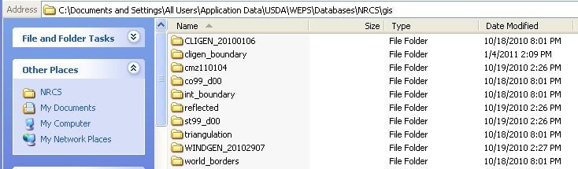
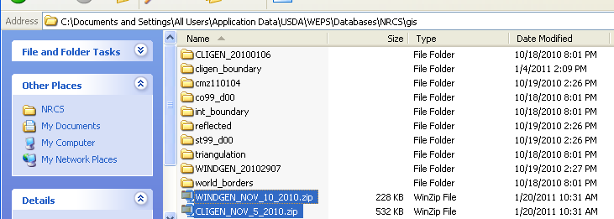
Gis file changes
Current Cligen shape file directory
Current Windgen shape file directory
1. Place both the CLIGEN_NOV_5_2010.zip and WINDGEN_NOV_10_2010.zip files into the above gis subdirectory.
Two new shape file directories

Slide 7
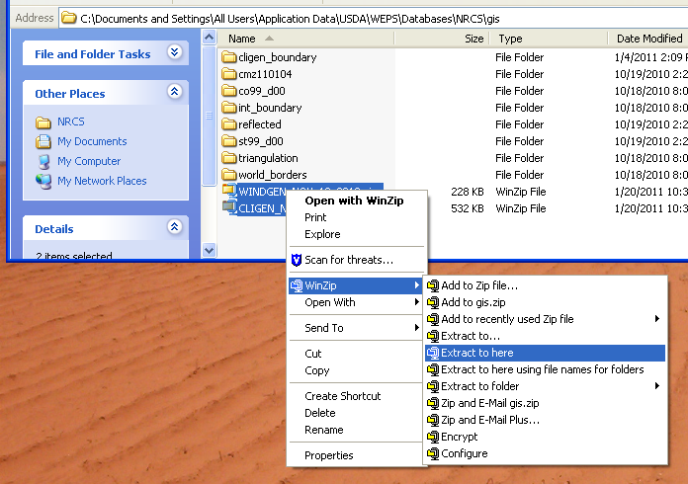
Gis file changes cont.
2. Delete the old files directory CLIGEN_20100106 and WINDGEN_20102907.
3. Unzip both of the new files. (Highlight and right click both new zipped files, then click Extract to here).

Slide 8
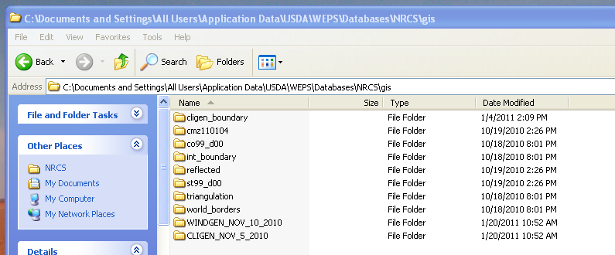
Gis file changes cont.
4. Finally delete both of the zipped files leaving only the new Windgen and the Cligen directories in the gis subdirectory.

Slide 9
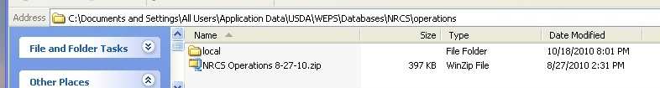
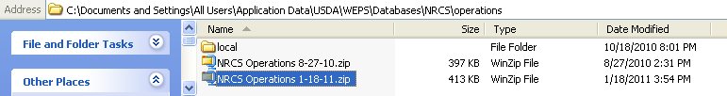

Operations file changes
The current file is
1. Place the new file, NRCS Operations 1-18-11.zip in the C:\Documents and Settings\All Users\Application Data\USDA\WEPS\Databases\NRCS\operations directory.
The new file is
2. Delete the NRCS Operations 8-27-10.zip file. DO NOT UNZIP! There should now be two subdirectories in the Crops subdirectory file, Local and the NRCS Operation 1-18-11.zip file.

Slide 10
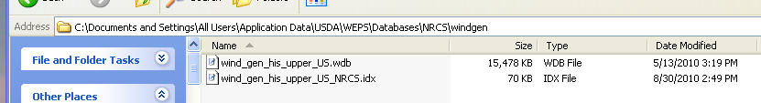
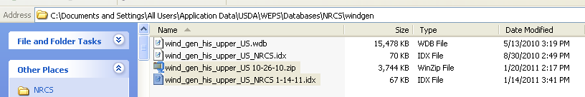
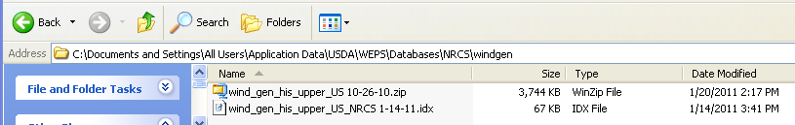
Windgen changes
Current windgen files
1. Save the wind_gen_his_upper_US_NRCS 1-14-11.idx and the wind_gen_his_upper_US.wdb to the C:\Documents and Settings\All Users\Application Data\USDA\WEPS\Databases\NRCS\windgen location.
New windgen files
2. Now remove the original files.
Current windgen files gone

Slide 11
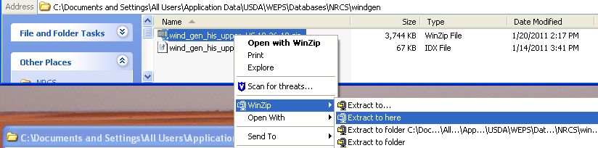
Windgen changes cont.
3. Unzip the wind_gen_his_upper_US 10-26-10.zip file. Use the extract to here function as we did for the gis windgen and cligen files on slide 6.

Slide 12
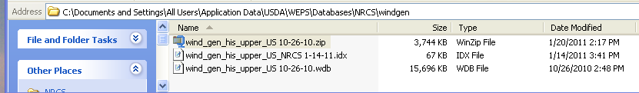
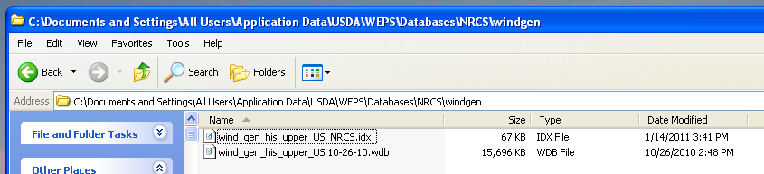
Windgen changes cont.
4. Delete the zipped wind_gen_his_upper_US 10-26-10.zip file
5. Finally, change the name of the wind_gen_his_upper_US_ NRCS 1-14-11.idx to remove the date out of the name. The new name should be wind_gen_his_upper_US_ NRCS.idx (no spaces in the name).
The replaced files should look like this

Slide 13
Translation.txt (last change needed)
1. Copy the RUSLE2_Translation1-25-2011.txt file to the C:\Documents and Settings\All Users\Application Data\USDA\WEPS\Databases\NRCS
2. Delete the Translation.txt dated 8/26/2010.
3. Rename the RUSLE2_Translation1-25-2011.txt to Translation.txt.

Slide 14
Finished
You now have the new databases installed.
The model should start and function the same way it did in the past.
Read the Notes attached to the email to understand what was changed.
If you have trouble call one of the names listed on the first slide.

Slide 15
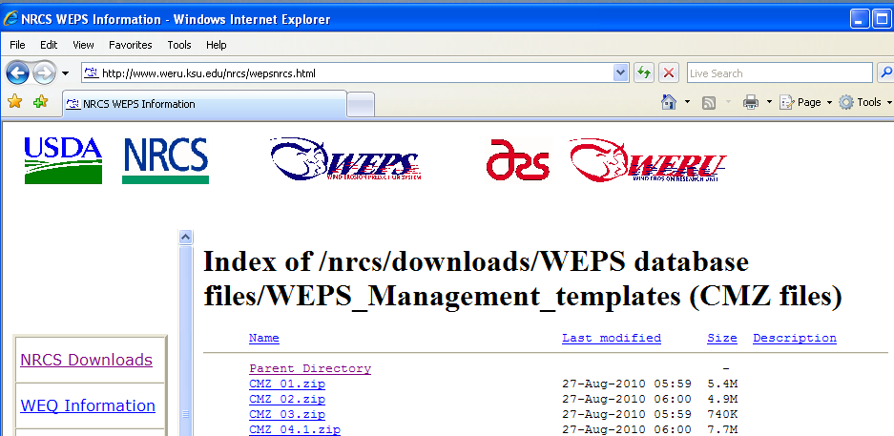
Management files
Users will need to delete any CMZ.zip folders and download the new set. Download from http://www.weru.ksu.edu/nrcs/wepsnrcs.html then to /nrcs/downloads/WEPS database files/WEPS_Management_templates (CMZ files) directory.
Users will need to use the Update Mgt files function to insert the correct new Crops and Operation information into locally made and stored managements. These are any management stored in the Local management directory. All old runs will have outdated management in the run folder unless the update process is used also.
Users should also be aware that the yields will be reset to the default values and the biomass adjustment factors will go back to 1.0 as with the update process.

Slide 16
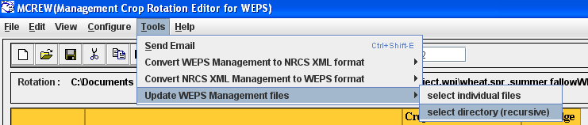
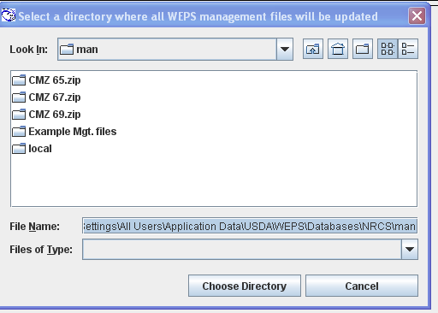
Database Update magement files
This process is used to update user made management files with the new information.
1. Open up the MCREW Editor (the Man button). Click the Tools, Update Management files, select directory (recursive).
A file chooser box will open where the management files are located.

Slide 17
Database Update magement files cont
2. In this case I want to update all of the managements in the local, and the Example Mgt. file directories. Click the local directory and then click the Choose Directory button. Repeat for the Example Mgt. files.
Make the selection of the directory and the then hit the “Choose Directory” button.

Slide 18
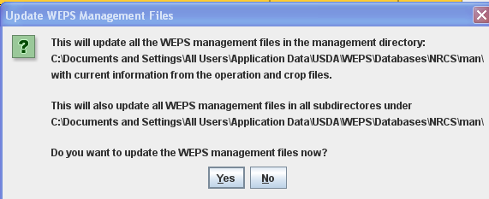
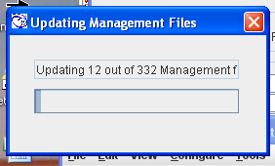
Database Update magement files cont
WEPS put up a message letting you know you cannot go back and undo this step.
WEPS lets you know that it is working with a small screen and graph to show the progress.

Slide 19
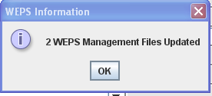
Database Update magement files cont
Finally WEPS ups a screen showing how many managements were updated.

